Slide 1
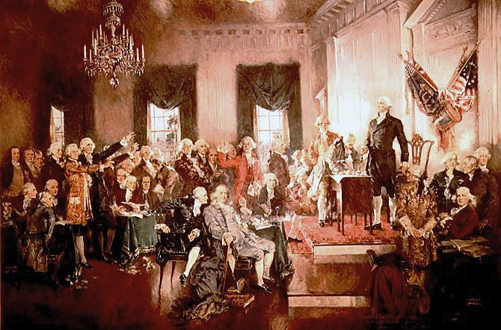
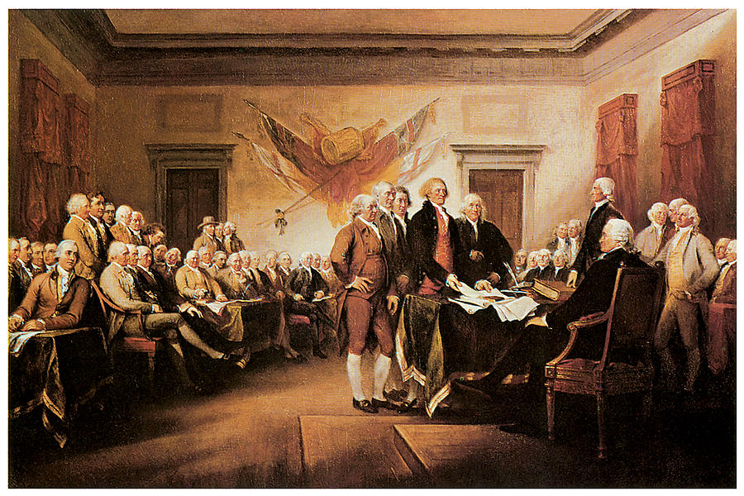
Unit 1
Historical Documents

Slide 2
U.S. separates from Britain
LOYALTY???
It’s been many generations since the British first came to American. American Colonist no longer saw themselves as British. They saw themselves as “Virginians, New Yorker, etc.
Major cause of the Revolutionary War:
“No Taxation Without Representation”
The American Colonist were under the control of King George III and the British Parliament. The Colonist did not have representation in the British Parliament so many believed that since they were not directly represented in the Parliament any laws it passed affecting the colonists were illegal under the Bill of Rights 1689, and were denied of their rights as Englishmen.

Slide 3
U.S. separates from Britain
Britain were in debt due to their own war’s and the French and Indian War.
British cracked down on Colonists doing business with France or their colonies.
(Smuggling) (Search Homes & Ships) (Losing money)
Sugar Act: Taxed foreign import goods.
If caught breaking the rule the colonist would be held in a vice-admiralty court (one judge) not colonist court (jury).
Stamp Act: imposed a tax on documents and printed items (wills, newspapers and playing cards).

Slide 4
John Locke
Locke: 17th century Enlightenment thinkers: Said People have their Natural Rights to Life Liberty and Property.
Social Contract: An agreement in which the people consent to choose and obey a government so long as it safeguards their Natural Rights. If the government violates that social contract by taking away or interfering with those rights people have the right to resist and even overthrow the government.

Slide 5
Thomas Paine
Paine: American political activist, philosopher and political theorist before and during the Revolutionary War.
Common Sense: Widely read 50 page pamphlet that attacked King George III and the Monarchy. Paine declared that Independence would allow Americans to trade more freely and give the colonists the chance to create a better society – one free from tyranny, with equal social and economic opportunities for all.

Slide 6
First Continental Congress
In September or 1774, 56 delegates met in Philadelphia to consider options including economic boycott of British trade, Colonist rights and grievances. They also petitioned King George III to readdress their grievances.
Drew up a declaration of colonial rights.
Run their own affairs and stated that, if the British used force against the colonies, the colonies should fight back.
Colonists in many Northeastern towns stepped up their military preparations. (Minutemen)

Slide 7
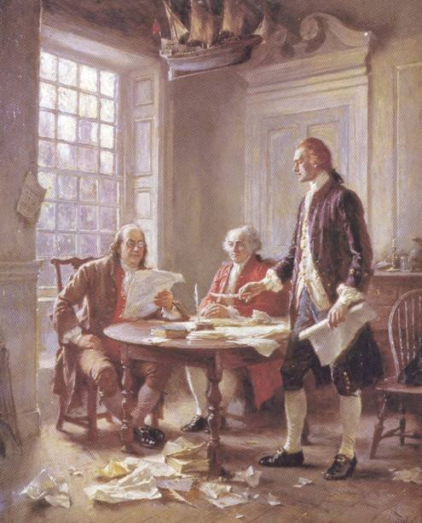
Declaration of Independence
Written June, July 1776
1st U.S. Document
Adopted on July 4, 1776
Continental Congress
56 signers
Wealthy, successful, & educated
“Free and Independent states”
Provides for the basic fundamental rights

Slide 8
In 1776 a five person committee was selected to write a declaration that the American Colonies were declaring themselves Independent from the British Empire. John Adams convinced the committee to allow Thomas Jefferson to compose this document, it took him 17 days to write. After some minor changes by Adams and Benjamin Franklin, the draft was presented to the Continental Congress on July 1st. The Continental Congress voted and approved the colonist Independence on July 2, 1776. Some believed this would be the most memorable day in American History.

Slide 9
In the early morning of July 4th, 1776, the Continental Congress finished its changes to the document and officially adopted the Declaration of Independence (Why we celebrate on the 4th). On August 2, 1776, delegates of the Continental Congress began signing the Declaration of Independence, eventually 56 delegates would sign. The colonist would continue to fight for America's Independence for another 7 years. The American Revolutionary War lasted for 8 year and 137 days.

Slide 10
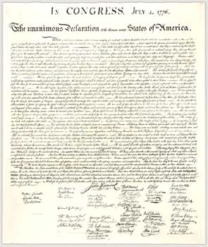
Declaration of Independence
This document declared the independence of the American colonies from Great Britain.
Thomas Jefferson, who wrote most of the Declaration, developed the argument for independence.

Slide 11
Declaration of Independence
“That all men are created equal, that they are endowed by their creator with certain unalienable rights, that among these are life, liberty, and the pursuit of happiness” (Natural Rights)
The function of government is to protect and serve these rights. If the government fails to do this, the people have a right to seek change.
Great Britain, under King George, was not serving the colonists’ rights; therefore, the colonists had a right to declare their independence.
The Declaration of Independence continues to serve today as the basic statement of our nation’s political philosophy.
http://www.ushistory.org/Declaration/document/index.html

Slide 12
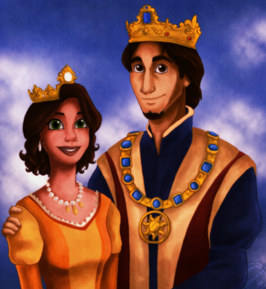
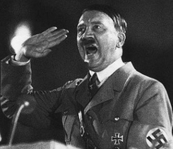
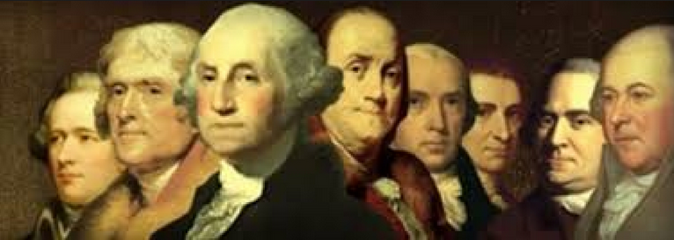
Let’s Start a New Government

Slide 13
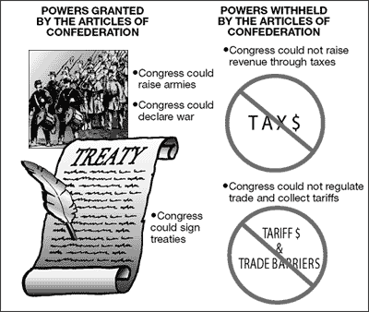
Articles of Confederation
Plan establishing a form of government called a confederation among the thirteen states (March 1781)
Each state remained sovereign
Set up a Congress in each state
Each state on vote regardless of Population
Population?
States would unite for
the common defense

Slide 14
Articles of Confederation
Can Do
Bad
Nation Government
Declare War
Make Peace
Sign Treaties
Barrow money
Set Standard Coins
Establish a Postal Service
Nation Government
Enact and collect Tax
Each state only had 1 vote regardless of population
9 out of 13 needed to pass laws
All states needed to agree to amend law
No President
No National Court system
13 national states that lacked Unity

Slide 15
Articles of Confederation
No Monetary System
13 different types of currency
Expansion & financial problems grew to great
State by State
George Washington suggests different course of action 1785

Slide 16
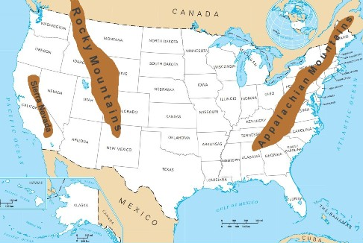
After the Revolutionary War many people settled west of the Appalachian Mountains. They ran into Native American land, Spanish and British Territory.
To help govern the land, congress passed the Land Ordinance 1785
Land Ordinance 1785: established a plan for surveying

Slide 17
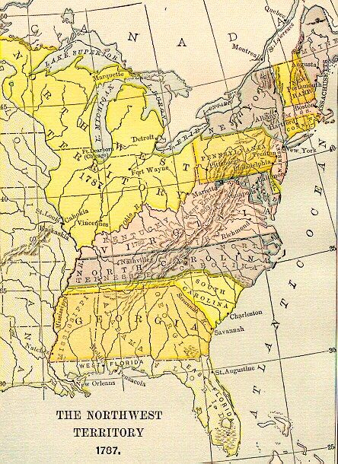
The Northwest Ordinance 1787
Main success of the Articles of Confederation
Provided guidelines for setting and governing new land
New states
The Ordinance served as a model for other territories

Slide 18
The Northwest Ordinance of 1787
The Northwest Ordinance: Congress created the Northwest Territory, which was lands beyond the Appalachian Mountains, South of the Great Lakes and North of the Ohio River. This was created due to multiple pressures:
Westward expansion of American settlers
Tense diplomatic relations with Great Britain and Spain, violent confrontations with Indians
Weaknesses of the Articles of Confederation
The empty treasury of the American government.

Slide 19
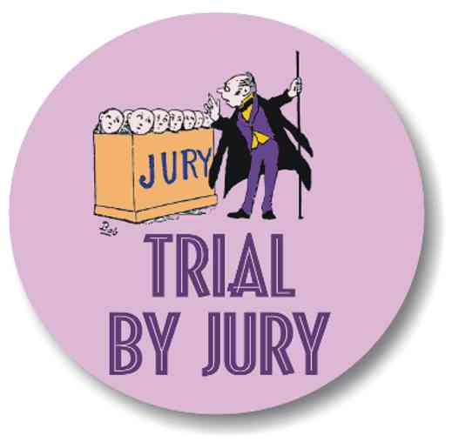
The Northwest Ordinance of 1787
By creating States out of these Territories the U.S. Government could now set rules and boundaries
Five new states
Ohio
Wisconsin
Michigan
Illinois
Indiana
Main features
Trail by jury
Prohibition slavery
Freedom of religion
Public education

Slide 20
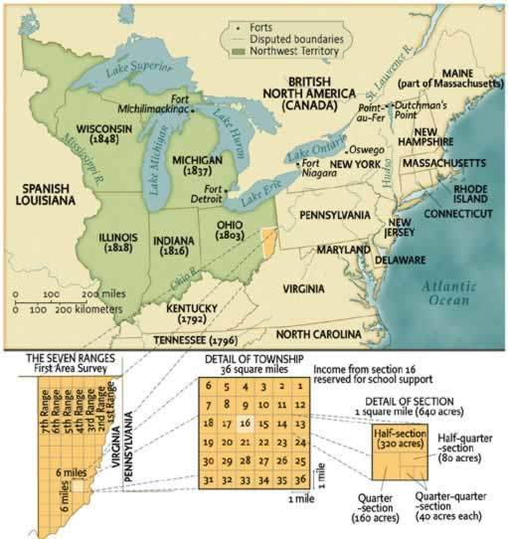
The Northwest Ordinance of 1787
How did the U.S. control Migration?
The Northwest Ordinance described how these new lands were to be governed. It was important because it set a pattern for orderly growth of the United States

Slide 21
Shays’ Rebellion
Under the Article of Confederation the National government tried to collected taxes from the States to pay the soldiers who fought in the Revolutionary war. Many of the States refused and the soldiers could not be paid. Many of the former soldiers had trouble taking care of their families and many of them lost their farms due to debt they couldn’t pay.
In January 1787 Daniel Shays organized a rebellion with other farmers that felt the same way he did.
Armed farmer stormed courthouses all over Massachusetts and wouldn’t let the judges in to the buildings and they tried to take over the Federal arsenal where weapons were kept.
A State Militia eventually had to put down Shays’ Rebellion. Over all Four men were killed, many others were wounded and others went to jail.

Slide 22
Shays’ Rebellion
Shay’s rebellion taught the national government that things needed to change the way they were done.
National Government could not TAX States, there for could not pay for an Army, each state was on their own.
How does the National Government put down a Rebellion, an attack or War? Under the Article of Conf. each state was on their own.
Shays’ Rebellion help lead the drafting of the U.S. Constitution.

Slide 23
Governments Vocabulary
Republic: Government in which citizens rule through their elected representatives
Representative democracy
Democracy: All People vote to make discussions
Authority rests with the people
Popular Sovereignty: The Right to vote for or against issues.

Slide 24
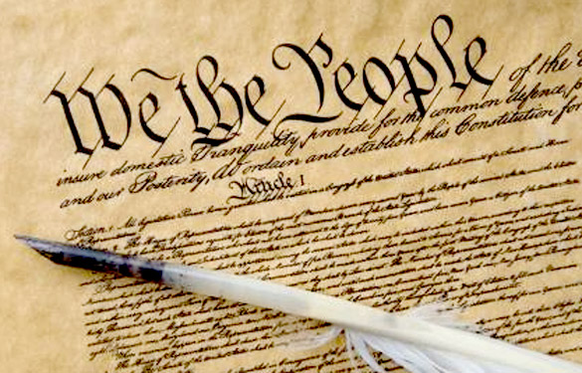
U.S. Constitution
U.S. Constitution
“Supreme Law of the Land”
7,000 words
Preamble
“We the people of the United States, in order to form a more perfect union, Establish Justice, Insure domestic Tranquility, provide for the common defense”
Articles
Seven areas of the constitution
http://study.com/academy/lesson/division-of-powers-between-the-national-government-and-the-states.html

Slide 25
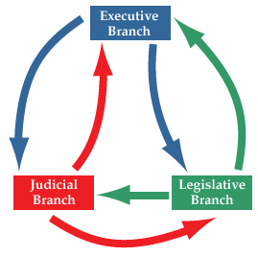
U.S. Constitution
Checks and Balances
Three branches not entirely separate nor completely independent
Each branch must answer to the other two branches
One branch can restrain the others
Example of Checks and Balances is the power to veto the President

Slide 26
U.S. Constitution
Separation of powers
Basic powers distributed and separated among the three branches
Legislative: Branch of government is associated with the United States
Congress
Senate: House of Representatives
Executive: Branch of government is associated with the White House
Judicial: Branch of government is associated with the Federal Court
Judicial Review
The power of the Supreme court to rule government acts or laws unconstitutional
Illegal

Slide 27
U.S. Constitution
The constitution is not perfect, therefore we must modify when needed
Amendments
Amend: To change or add
Amendments to the Constitution
27 total
Procedures for changes or additions are very difficult to enact and take long periods of time.
First 10 amendments are your Bill of Rights

Slide 28
U.S. Constitution Framework
 | Legislative | Executive | Judicial
Federal | Congress Article 1 | President Article 2 | U.S. Supreme Court Article 3
State | General Assembly | Governor | Ohio Supreme Court
Local | City Council | Mayor | County Court

Slide 29
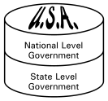
Definitions
Federalism
Division between federal and state Government
National Government
State Government

Slide 30
Definitions
How and why did the framers of the Constitution adopt federalism as a framework for government?
it allowed for power to be shared between federal and state governments to that there was not "central" government with absolute power

Slide 31
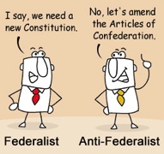
Federalists vs. Antifederalists
Federalists: Supported the a new Constitution’s balance of power between the states and national government.
Antifederalist: Opposed having a strong central government so they opposed the Constitution.

Slide 32
Federalists vs. Antifederalists
Federalists
Constitution had a stronger central government then the weak congress by the Articles of Confederation
Wanted
President
Monetary System
Judicial System
Checks and Balances in the government
Antifederalists:
Constitution did not guarantee the government would protect the people rights or states
Wanted
Freedom of the Press
Freedom of Religion
Against unreasonable search of people and their homes
Right to Trial by Jury
THEY WANTED A BILL OF RIGHTS

Slide 33
Why a Bill of Rights?
Anti-Federalist wanted a Bill of Rights to protect the Peoples individual rights against the Federal Government and the U.S. Constitution.
The Bill of Rights lists specific prohibitions on governmental power and lists peoples individual rights.

Slide 34
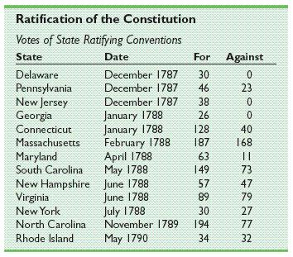
Bill of Rights
The Federalists gave in and promised to add a Bill of Rights to the Constitution if the States would ratify the Constitution.
June 1788, New Hampshire became the ninth state to approve the Constitution, making it the law of the land.

Slide 35
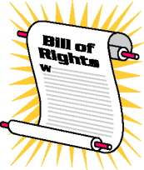
Bill of Rights First 10 Amendments which grant civil liberties and rights.
U.S. Const. listed no basic rights for citizens
15+ amendments recommended
Proposed in 1789 and ratified in 1792
¾ states had to agree

Slide 36
Bill of Rights First 10 Amendments
First amendment
Freedom of Religion, Speech, Press, Assembly, and Petition
Second amendment
Right to bear Arms
Third amendment
Quartering of Soldiers
Fourth amendment
Search and Seizures

Slide 37
Bill of Rights First 10 Amendments
Fifth amendment
Criminal proceedings, Due process, Eminent domain (You don’t have to testify against your self)
Sixth amendment
Rights of the accused
Seventh amendment
Civil Trials
Eighth amendment
Punishment for crimes (Can’t get hand cut off Million dollar bail)

Slide 38
Bill of Rights First 10 Amendments
Ninth amendment
Unremunerated Rights
Means: to repay or reward
addresses rights of the people that are not specifically enumerated in the Constitution.
Tenth amendment
Powers reserved to the states (States can make their own laws)

